Slide 1
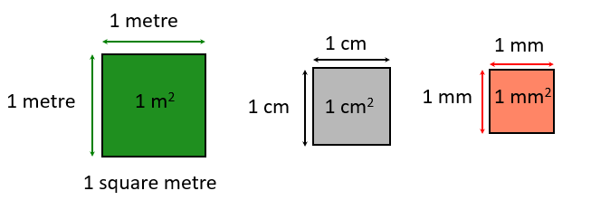
Introduction to AREA

Slide 2
Lesson OBJECTIVE:
By the end of the lesson you should have:
Added a variety of shape formulas to your notes
Increased your current understanding of area in regards to rectangles, triangles and squares.

Slide 3

Area Eq: HOW does the formula for a rectangle RELATE TO THE FORMULA OF A TRIANGLE?
What is Area: Area is the size of a surface. The amount of space inside the boundary of a flat, 2-dimensional object.
What is perimeter: Perimeter is the border around a shape. An example of this would be the fence around BSC.
This is a conversion chart. You must always make sure your units of measurement are the same.

Slide 4
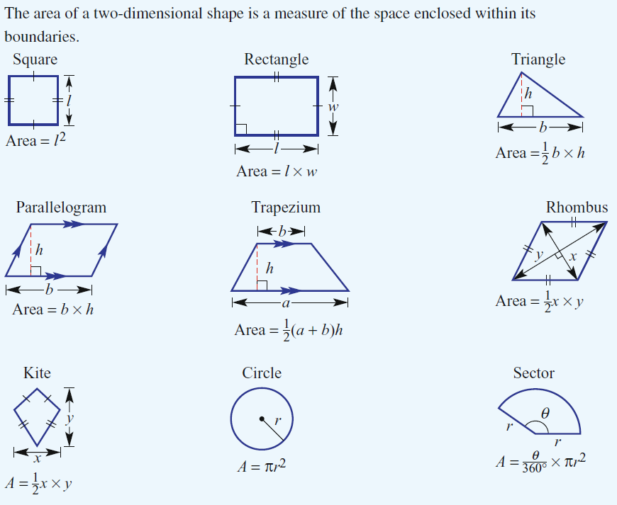
Basic Shape Formulas

Slide 5
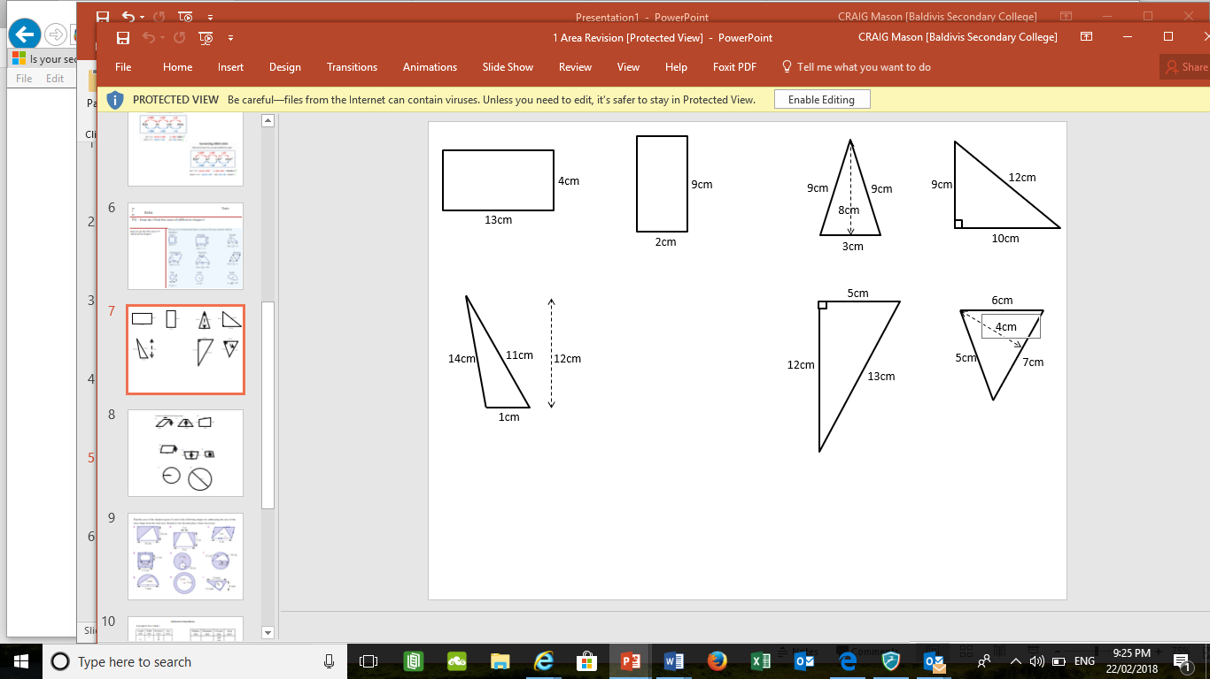
Rectangles and Triangles .

Slide 6
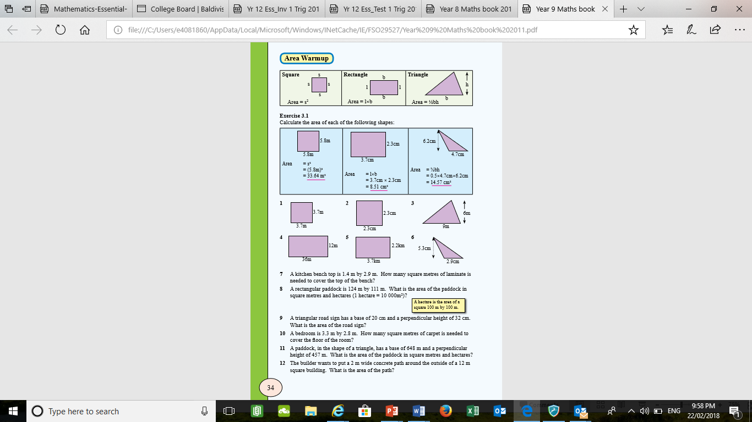

Slide 7

To conclude: If you answered/attempted the work….

